Slide 1
Software Architecture and Design I SOEN 343 Instructor: Dr. Rodrigo Morales https://moar82.github.io/ rodrigo.moralesalvarado@concordia.ca
Lecture 12: DISTRIBUTED ARCHITECTURE II
RESTful API:
https://searchapparchitecture.techtarget.com/definition/RESTful-API
REST API: Exploring the Basic features by Santanu Chakraborty
Notes:
1

Slide 2
API
An API for a website is code that allows two software programs to communicate with each another
The API spells out the proper way for a developer to write a program requesting services from an operating system or other application.

Slide 3
What is RESTful API?
A RESTful API in architectural style and approach to communications often used in web services development
REST technology is generally preferred to the more SOAP technology because it consumes less bandwidth, making it more suitable for internet usage
Notes:
A RESTful API -- also referred to as a RESTful web service -- is based on representational state transfer (REST) technology, an architectural style and approach to communications often used in web services development
REST technology is generally preferred to the more robust Simple Object Access Protocol (SOAP) technology because REST leverages less bandwidth, making it more suitable for internet usage

Slide 4
The REST used by browsers can be thought of as the language of the internet
With cloud use on the rise, APIs are emerging to expose web services
REST is a logical choice for building APIs that allow users to connect and interact with cloud services
RESTful APIs are used by such sites as Amazon, Google, LinkedIn and Twitter

Slide 5
History of RESTful APIs

Slide 6
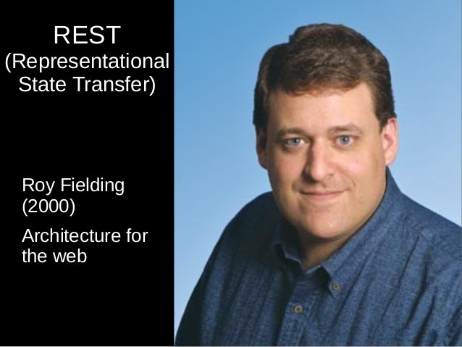
REST history
Prior to REST, developers used Simple Object Access Protocol (SOAP) to integrate APIs
In 2000, Roy Fielding and a group of developers decided to create a standard so that any server could talk to any other server
Notes:
Prior to REST, developers used Simple Object Access Protocol (SOAP) to integrate APIs. To make a call, developers handwrote an XML document with a Remote Procedure Call (RPC) call in the body. They then specified the endpoint and POST their SOAP envelope to the endpoint
In 2000, Roy Fielding and a group of developers decided to create a standard so that any server could talk to any other server. He defined REST and the architectural constraints explained above in his 2000 PhD dissertation at UC Irvine. These universal rules make it easier for developers to integrate software.

Slide 7


Salesforce and Ebay
Salesforce was the first company to sell an API as part of their “Internet as a Service” package in 2000
EBay built a REST API, which expanded its market to any site that could access its API
Notes:
Salesforce was the first company to sell an API as part of their “Internet as a Service” package in 2000
However, few developers were actually able to use the complicated XML API. EBay built a REST API, which expanded its market to any site that could access its API. This caught the attention of another ecommerce giant, and Amazon announced its API in 2002.

Slide 8
Flickr launched its own RESTful API in August 2004, enabling bloggers to easily embed images on their sites and social media feeds
Facebook and Twitter both released their APIs in 2006
When Amazon Web Services (AWS) helped launch the cloud in 2006, developers were able to access data space in minutes using AWS’s REST API, and the request for public APIs quickly escalated
Since then, developers have embraced RESTful APIs, using them to add functionality to their websites and applications
Notes:
Flickr launched its own RESTful API in August 2004, enabling bloggers to easily embed images on their sites and social media feeds. Facebook and Twitter both released their APIs in 2006, buckling under the pressure of developers who scraped the sites and created “Frankenstein” APIs. When Amazon Web Services (AWS) helped launch the cloud in 2006, developers were able to access data space in minutes using AWS’s REST API, and the request for public APIs quickly escalated.
Since then, developers have embraced RESTful APIs, using them to add functionality to their websites and applications

Slide 9
How RESTful APIs work

Slide 10
RESTful API breaks down a transaction to create a series of small modules
Each module addresses a particular underlying part of the transaction
This modularity provides developers with a lot of flexibility, but it can be challenging for developers to design from scratch
Currently, the models provided by Amazon S3, Cloud Data Management Interface (CDMI) and OpenStack Swift are the most popular

Slide 11
A RESTful API explicitly takes advantage of HTTP methodologies defined by the RFC 2616 protocol.
They use GET to retrieve a resource; PUT to change the state of or update a resource, which can be an object, file or block; POST to create that resource ; and DELETE to remove it
With REST, networked components are a resource you request access to -- a black box whose implementation details are unclear
The presumption is that all calls are stateless; nothing can be retained by the RESTful service between executions
Notes:
A RESTful API explicitly takes advantage of HTTP methodologies defined by the RFC 2616 protocol.
They use GET to retrieve a resource; PUT to change the state of or update a resource, which can be an object, file or block; POST to create that resource ; and DELETE to remove it
With REST, networked components are a resource you request access to -- a black box whose implementation details are unclear
The presumption is that all calls are stateless; nothing can be retained by the RESTful service between executions

Slide 12
REST is applied to web services
HTTP-based RESTful APIs are categorized with the following aspects: base URI; an Internet media type for the data, standard HTTP methods, hypertext links to reference-related resources
Each part of uniform interface evolves independently
Notes:
REST is applied to web services
HTTP-based RESTful APIs are categorized with the following aspects: base URI; an Internet media type for the data, standard HTTP methods, hypertext links to reference-related resources, it decouples and simplifies the architecture
Each part of uniform interface evolves independently

Slide 13
REST provides uniform interface separating clients from servers; it improves the portability of the client code; servers are simpler and scalable
Stateless – while processing requests, client context is not stored on the server; the information required to service the request is contained in the request itself; session state is held in the client
Cacheable – no client/server interactions are needed when the page is well managed and cached; the responses are cached by clients and intermediaries; only implicit or explicit definition of responses should exist

Slide 14
Because the calls are stateless, REST is useful in cloud applications
Stateless components can be freely redeployed if something fails, and they can scale to accommodate load changes
This is because any request can be directed to any instance of a component; there can be nothing saved that has to be remembered by the next transaction
That makes REST preferred for web use, but the RESTful model is also helpful in cloud services because binding to a service through an API is a matter of controlling how the URL is decoded.
Cloud computing and microservices are almost certain to make RESTful API design the rule in the future

Slide 15
RESTful API Design and Architecture Constraints

Slide 16
REST architectural constraints 1/2
Use of a uniform interface (UI). Resources should be uniquely identifiable through a single URL, and only by using the underlying methods of the network protocol
Client-server based. There should be a clear delineation between the client and server
Data access, workload management and security are the server’s domain
This loose coupling of the client and server enables each to be developed and enhanced independent of the other
Notes:
In order to be a true RESTful API, a web service must adhere to the following six REST architectural constraints:
Use of a uniform interface (UI). Resources should be uniquely identifiable through a single URL, and only by using the underlying methods of the network protocol, such as DELETE, PUT and GET with HTTP, should it be possible to manipulate a resource
Client-server based. There should be a clear delineation between the client and server. UI and request-gathering concerns are the client’s domain
Data access, workload management and security are the server’s domain
This loose coupling of the client and server enables each to be developed and enhanced independent of the other.

Slide 17
REST architectural constraints 2/2
Stateless operations. All client-server operations should be stateless, and any state management that is required should take place on the client, not the server
RESTful resource caching. All resources should allow caching unless explicitly indicated that caching is not possible
Layered system. REST allows for an architecture composed of multiple layers of servers
Code on demand. Most of the time a server will send back static representations of resources in the form of XML or JSON. However, when necessary, servers can send executable code to the client

Slide 18
REST Services in Various Technologies

Slide 19
REST can be used in many languages, regardless of the technology used by the consumer developer
Examples are .NET/C#, Java, Perl, Node/JavaScript, ActionScript, PHP, Python, Ruby
Ways in which we can implement REST are by sending HTTP GET or POST requests in each language; by calling HTTP Client requests; using AJAX, JSON, and asynchronous JavaScript calls; invoking directly from a web browser in case of GET request

Slide 20
Example: GitHub Rest API

Slide 21
Finding repositories with Java
Imagine that you are interested to list GitHub repositories in Java with more than 20 stars and pushed after 2013-03-01
You also want to be sure that they are not mirrors of other repositories, and perform a descending order on the data retrieved
Using the API you can retrieve results directly to your browser as JSON format

Slide 22
Example
Copy the following in your browser
https://api.github.com/search/repositories?q=language:java+stars:%3E20+pushed:%3E2013-03-01+mirror:false+is:public&sort=stars&order=desc&per_page=100&page=1

Slide 23
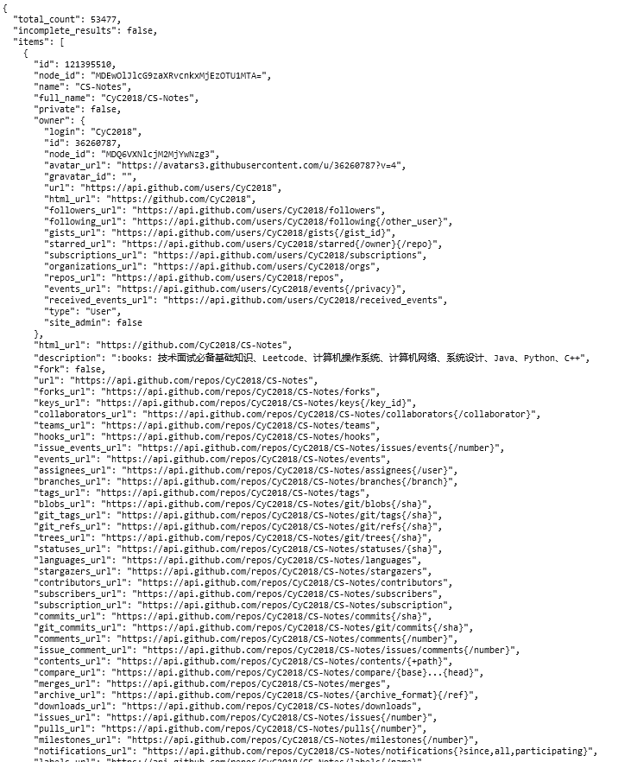
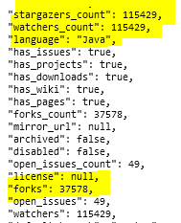

Slide 24

Saving the information to a file
With simple UNIX commands like curl, you could have saved that information as a file for latter processing
Crawling the web is simplified by using REST API
Facebook, Twitter and all your favorite social media provide APIs to query information
For example, you could add a widget to your personal website with your latest posts, thanks to that

Slide 25
REST vs. SOAP

Slide 26
REST versus SOAP
In REST, public APIs are exposed over the Internet to handle CRUD operations on data
In SOAP, pieces of application logic are exposed as service with their own protocol
REST focuses on accessing named resources through a single consistent interface
SOAP focuses on accessing named operation
REST provides more web-based services because of the HTTP client-based behavior
With REST the client creation, API development, and documentation is easier to understand
REST permits many different data formats
The performance and scalability are better than SOAP
The data can be cached
Notes:
CRUD stands for Create, Read, Update, and Delete, which are four primitive database operations.

Slide 27
Why SOAP?
Security – SOAP supports SSL as well as WS-Security that adds some enterprise security features
SOAP supports identity through intermediaries
SOAP provides a standard implementation of data privacy and data integrity
Atomic transaction – it also provides ACID transaction support, provides multiphase commit across different distributed transactional resources
Reliable messaging – better standard messaging system; no communication failures occur; it provides end-to-end reliability even via SOAP intermediaries
Notes:
ACID refers to the four key properties of a transaction: atomicity, consistency, isolation, and durability

Slide 28
Final remarks 1/2
REST and SOAP offer different methods to invoke a web service
RESTful web services are stateless
A REST-based implementation is simple compared to SOAP, but users must understand the context and content being passed along, as there’s no standard set of rules to describe the REST web services interface
REST services are useful for restricted profile devices, such as mobile, IoT, and are easy to integrate with existing websites

Slide 29
Final remarks 2/2
REST provides different formats to serialize and post data. It includes POX, RSS, JSON
REST uses HTTP verbs like GET, POST, PUT, and DEL to process request, whereas SOAP uses different protocols to service request:
SMTP connections via TCP protocol, HTTP POST via form coded URI and MQ data transport
REST service consists of resource that are addressable using URI and naming patterns, whereas SOAP uses endpoint to process the connection among subsequent requests

